Slide 1
802.15.4 Project
The Northernites
Sam Weismuller, SangRyul “Eric” Pae, Jay Cordaro
MAS 2023 Students UC San Diego

Slide 2
Overview of Progress
Tx and Rx simulations completed
Selected RF Front End part
Selected FPGA board
Implemented SPI interface between the Teensy and the FPGA
Implemented SPI interface between the Teensy and RF Front End
Completed Teensy implementation to transmit and receive 802.15.4 packets by reading and writing payload data from an SD card
Lowered the scope for final project to a file based-transceiver, cut out speaker and microphone

Slide 3
Challenges
FPGAs from Intel, Xilinx, Lattice simply not available!
Selected Efinix T20 EVB & learned toolchain
Teensy audio board not functioning, only emits high-pitched sounds
Switched from DDS+Mixer TX and Mixer + ADC RF FE to Microchip part
Great part but funky LVDS interface
Could not leverage UW code since we were not on Lattice platform

Slide 4
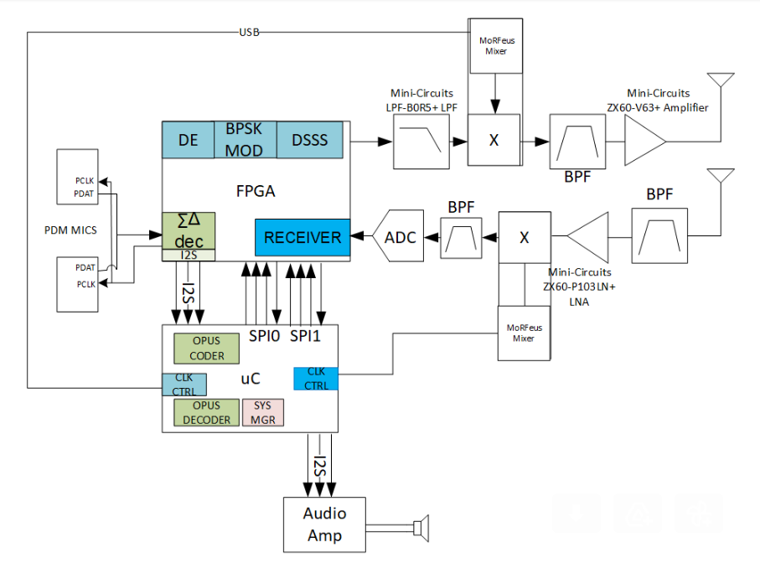
Original System

Slide 5
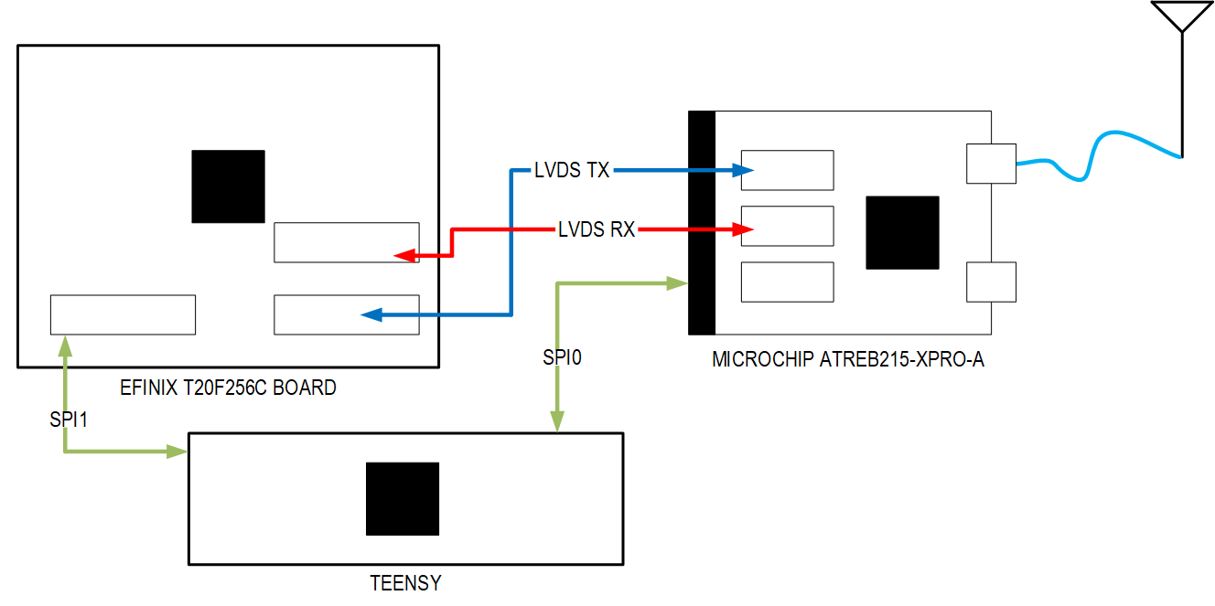
New MVP
16 or 32MHz CLK
Trion
T20
Atmel
NXP

Slide 6
Lowering the Scope
From real-time transceiver to file-based transceiver
Allows us to lower the packet rate
No need to interface with an audio front end
Eliminates I2S interfaces from Teensy to FPGA and speaker
One SPI interface between Microcontroller and FPGA instead of two
RF-front End is now being handled by a single chip
Simplifying the PHY interface
Not a true adaptation of 802.15.4
Data rate will be a multiple of the IQ rate of the Atmel part
No CSMA
Fixing this non-compliances will be a stretch goal

Slide 7
802.15.4 Project MATLAB Simulations

Slide 8
Tx Simulation
Generates PHY header and example payload
Generates the chip sequences from the input bits
Modulates chip sequences with pulse-shaped BPSK

Slide 9
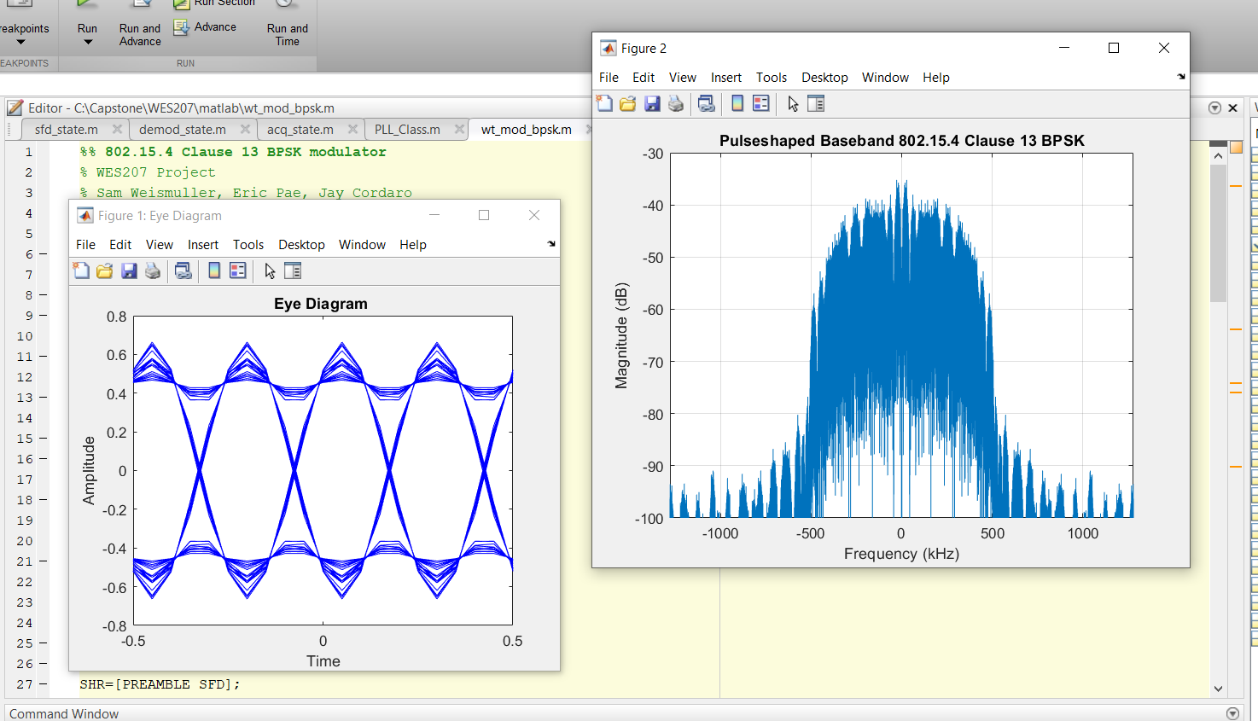
Tx Simulation

Slide 10
Rx Simulation
Detects beginning of preamble with a matched filter for the chip sequence and gets initial timing estimate
Searches symbol-by-symbol for the end-of-preamble pattern
Reads the length of the packet from the PHY header
After the header, outputs demodulated bits to a buffer
Runs a PLL on matched filter outputs to correct phase and frequency error

Slide 11
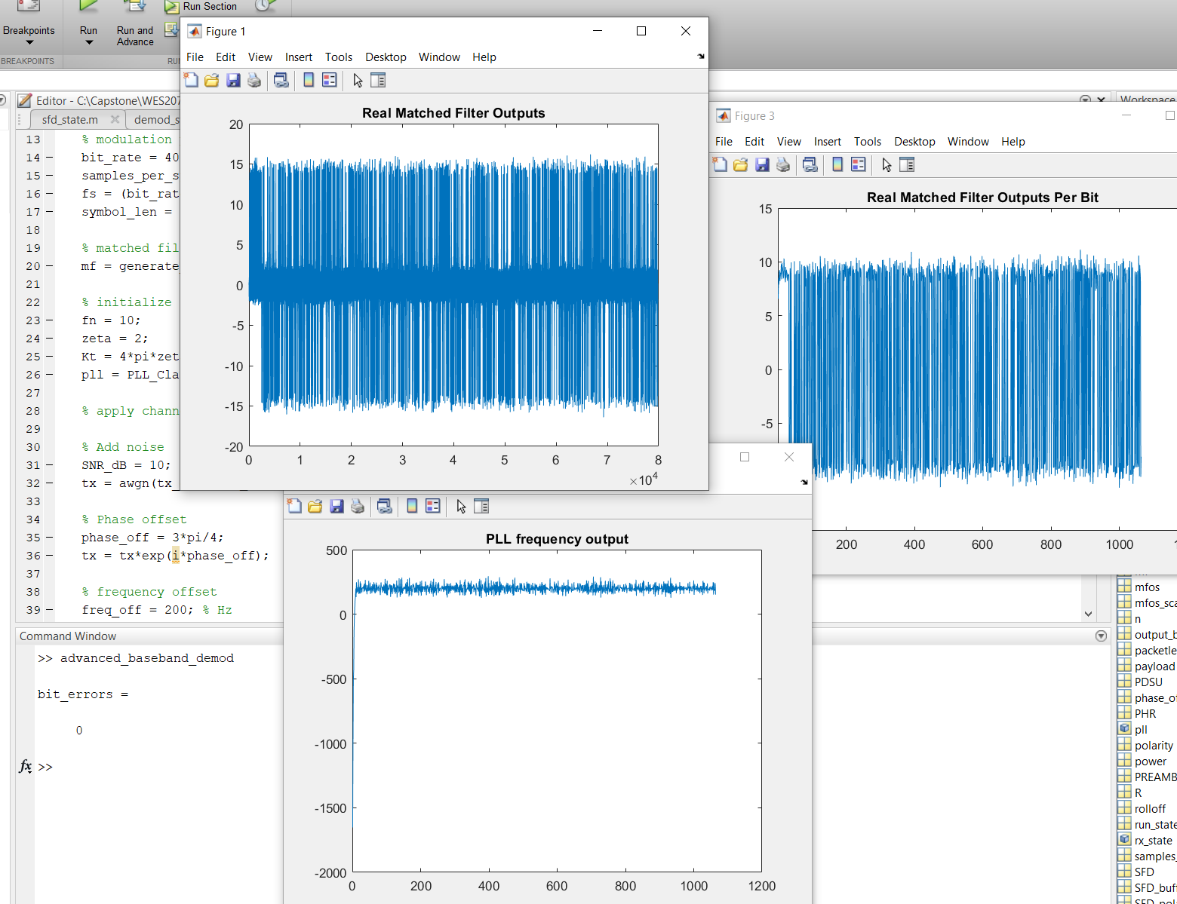
Rx Simulation Demo- 10 dB SNR

Slide 12
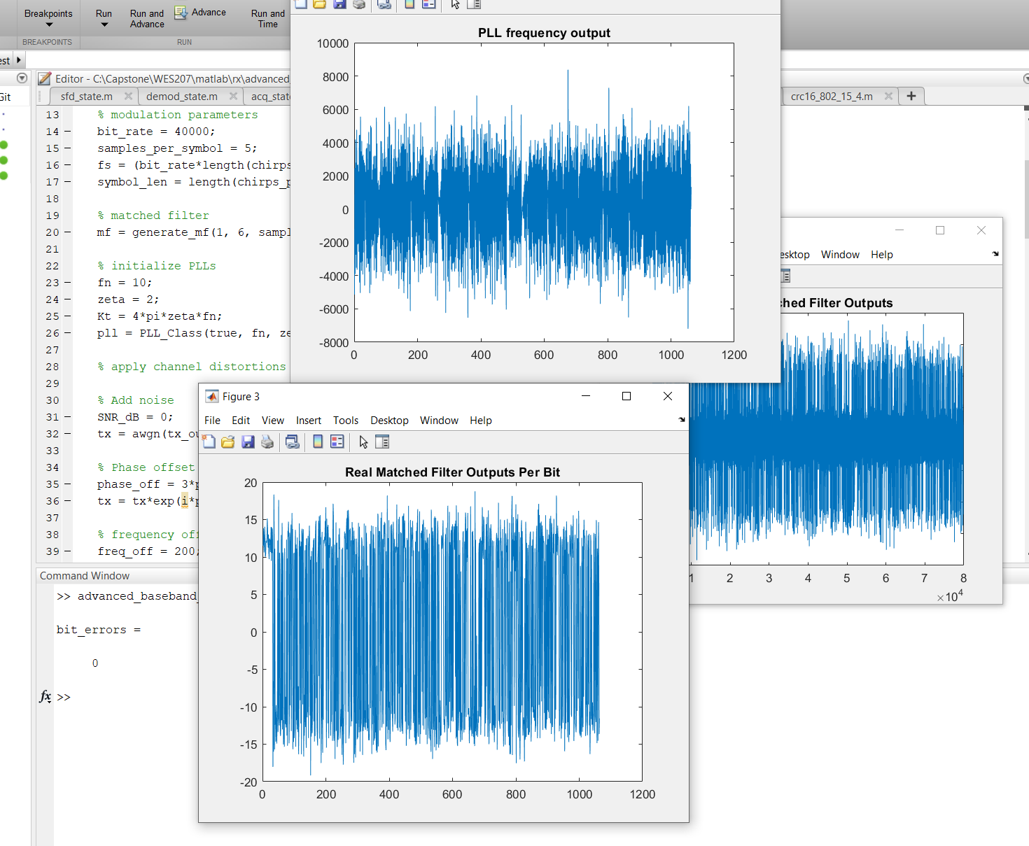
Rx Simulation Demo- 0 dB SNR

Slide 13
802.15.4 Project Microcontroller

Slide 14
Overview
Microcontroller is now complete for the MVP
It interfaces with the RF front end and FPGA over SPI
It can send and receive data from the FPGA and save the results to the SD card

Slide 15
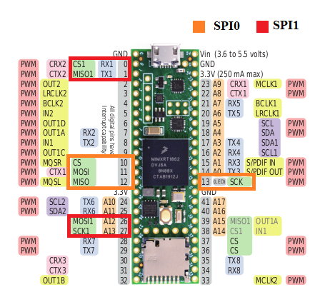
SPI Interfaces
SPI0- RF front end control
Interface defined by Atmel documentation
SPI1- FPGA packet transfer and control
Interface designed by us

Slide 16
File-based Transceiver
Software completed for file-based transceiver MVP
Sends and receives data from the FPGA over the SPI interface
Configurable through commands sent via USB serial connection
Two modes
Opus mode- Sending audio data
BER Test- For measures the bit-error rate of the system, crucial for testing and verification

Slide 17
Opus Mode
Reads a 16-bit PCM audio file from the SD card
Encodes the audio with the Opus codec
Encapsulates the Opus-encoded data in a 802.15.4 packet
Sends the packet the FPGA
Receives a packet from the FPGA
Verifies the packet header and CRC
Extracts the payload of the packet and sends it through the Opus decoder
Writes the decoded audio to a file

Slide 18
BERT Mode
Can be configured to various common test patterns (including PRBS)
Generates data with the configured bit pattern
Encapsulates the in a 802.15.4 packet
Sends the packet the FPGA
Receives a packet from the FPGA
Verifies the packet header and CRC
Extracts the payload of the packet and checks it against the pattern for bit errors
Writes the BER test result to a file

Slide 19
Commands
OPUS: Commands the Teensy to Opus mode:
on transmit it will encode Input.bin with the opus codec
on receive it will decode the rx data with the opus codec and write to an out bin file (file name will be printed on serial log)
BERT: Commands the Teensy to Bit Error Rate Test mode:
on transmit it will send a fixed bit pattern
on receive it will check for bit errors with the configured pattern on write the results to BERT.txt
The following patterns can be entered:
MK - all ones
SP - all zeroes
ONE_ONE - repeating 1 followed by 0 pattern
ONE_SEVEN - repeating 1 followed by seven zeroes pattern
ONE_FIFTEEN - repeating 1 followed by fifteen zeroes pattern
PRBS_63 - PRBS with k=6
PRBS_127 - PRBS with k=7
TRX: Commands the Teensy to transmit and then receive what it transmitted
TX: Commands the Teensy to transmit
RX: Commands the Teensy to receive
CANCEL: If a TX/RX operation is active, this will cancel out of it

Slide 20
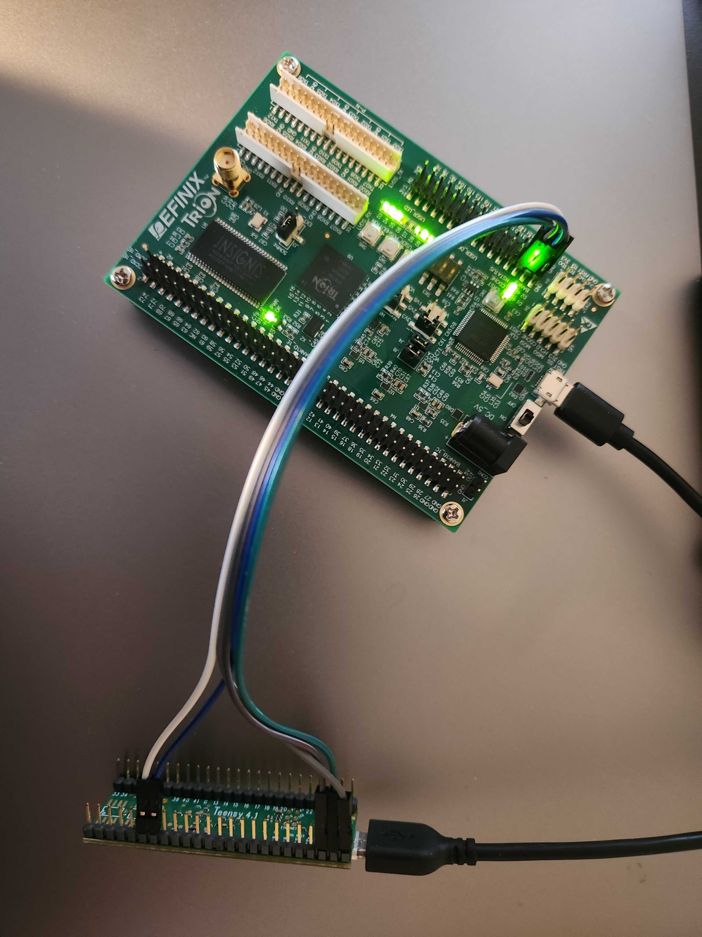
Demo

Slide 21
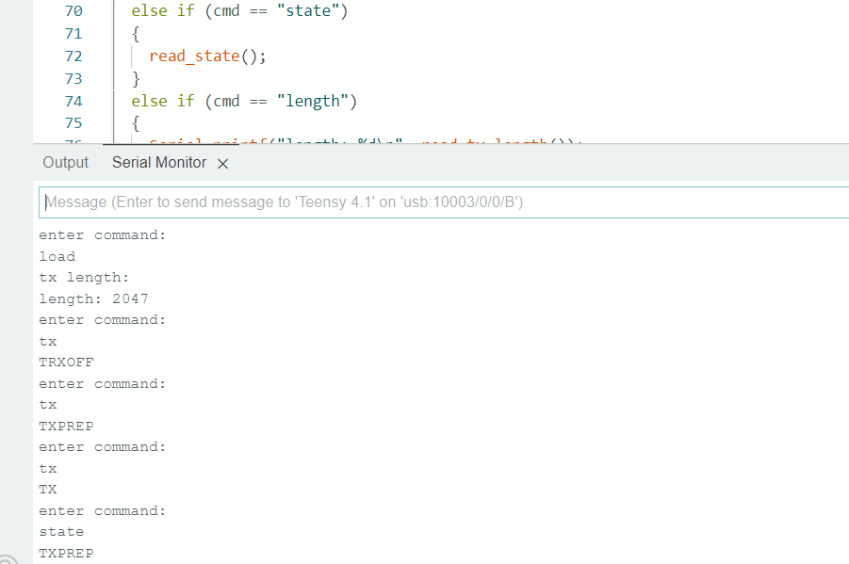
Future Work
If our goal is to create a file-based transceiver use the FPGA, the microcontroller is complete
If the FPGA-RF interface is unable to function, we may have to resort to directly controlling the RF Front End with the Teensy in OQPSK mode
We have already created a sample implementation of this

Slide 22
802.15.4 Project RF Front End & Mixed Signal
(ATREB215-XPRO-A:AT86RF215)

Slide 23
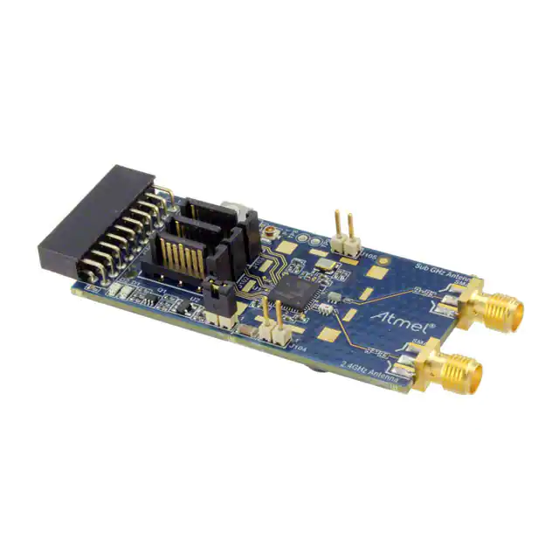
ATREB215-XPRO-A
RF Front End
IQ radio for 909 MHz band
Controllable via SPI and LVDS

Slide 24
Progress
Checked if IQ rado mode TxD_P/N route is open and working properly through LVDS.
Tried interoperability between FPGA Tx & Transceiver Tx via LVDS.
Checked necessary function control of the transceiver in IQ radio mode via SPI.
Checked FPGA operations required for the transceiver via SPI.

Slide 25
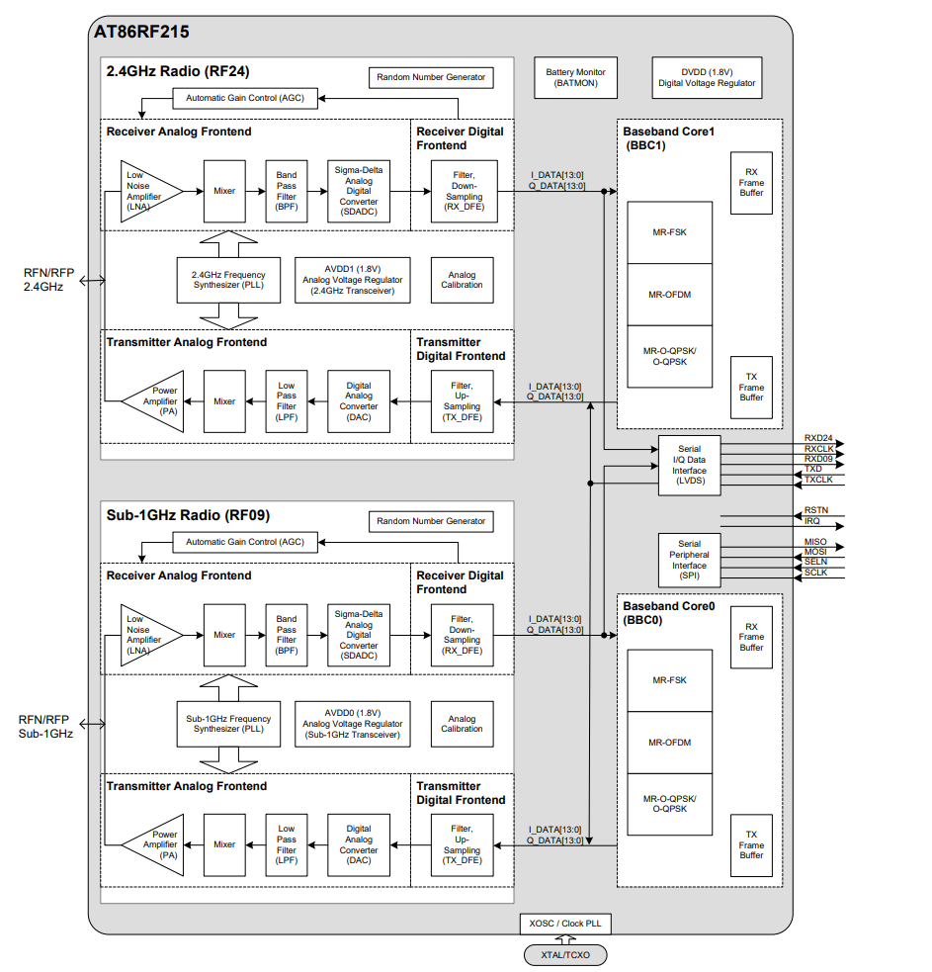
Block Diagram

Slide 26
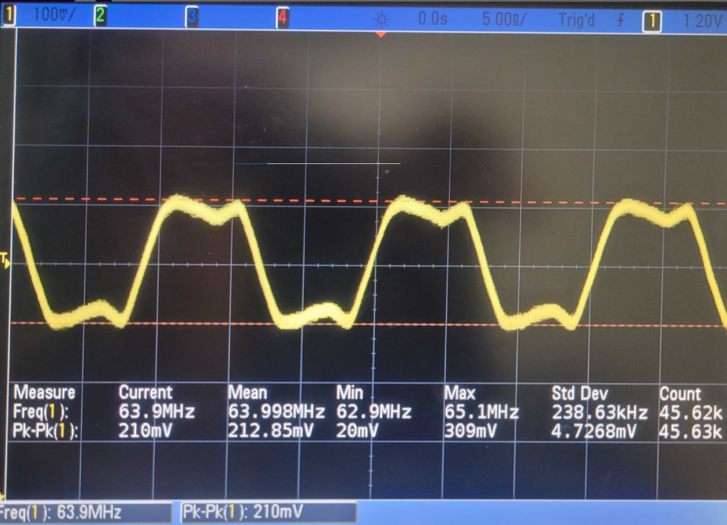
LVDS Functionality in I/Q Radio Mode-1
Status check when I/Q Radio Mode enabled.
RxCLK_P/N is on as default.

Slide 27
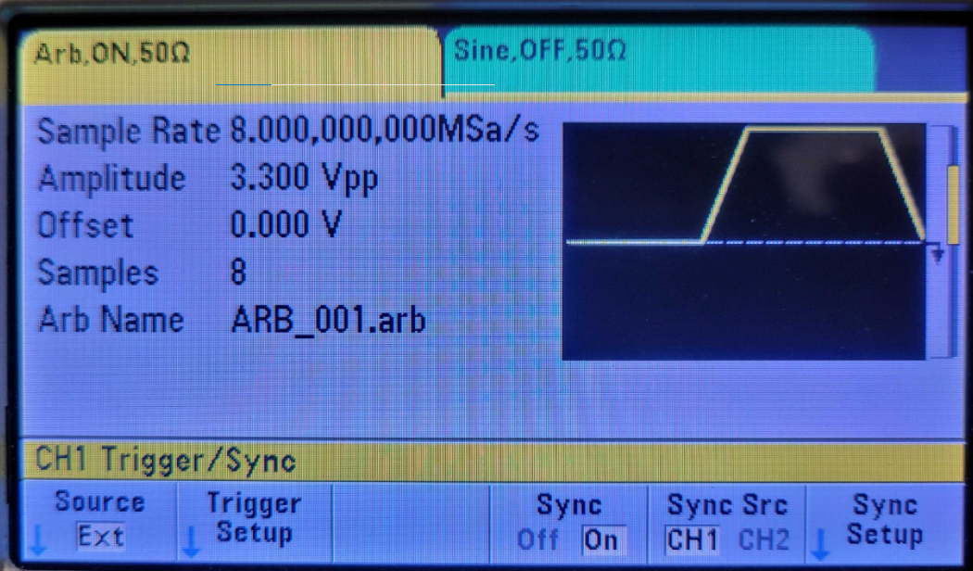
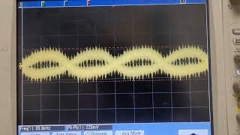
LVDS Functionality in I/Q Radio Mode-1
Checked if TxD_P/N path is open and functioning with Function generator.
Fed RxCLK_P/N to TxCLK_P/N and provided arbitrary waveform with function generator and sync’ed to give 32 ‘0’s & Downconverted to 100kHz.
Toggled IF WF by sync on/off of function generator
( * found the ‘sync’ gave big 1MHz pulse and made it happen )

Slide 28
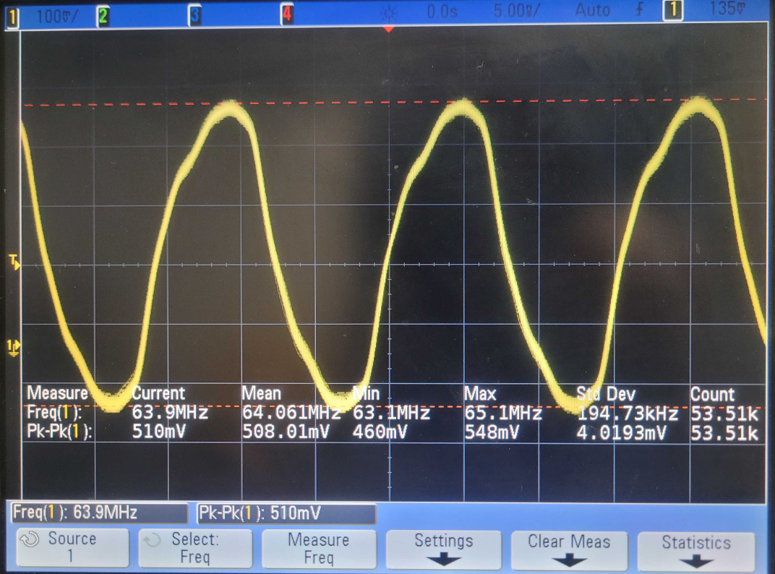
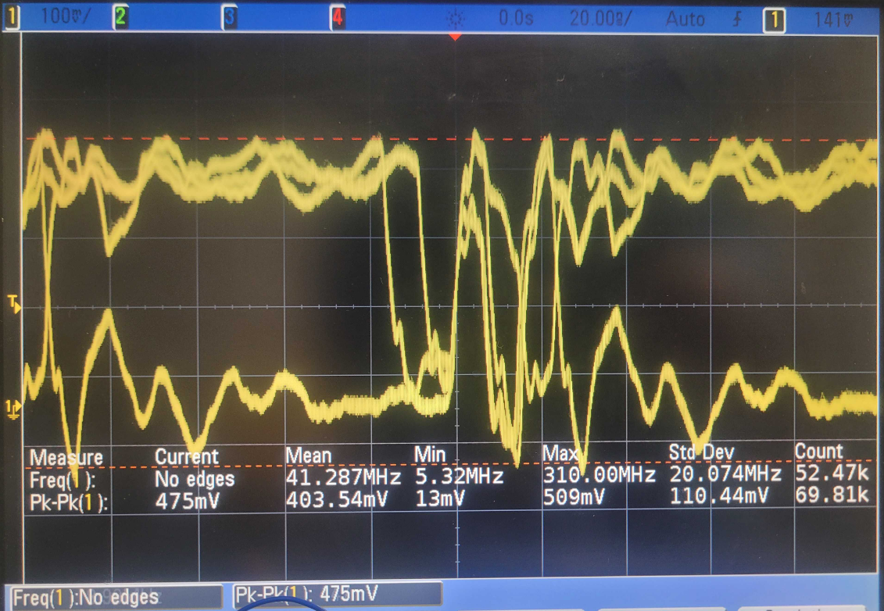
LVDS Functionality in I/Q Radio Mode-2
Checked if TxD_P/N path is open and functioning with FPGA generated clock and data..
Clock from FPGA data from FPGA

Slide 29
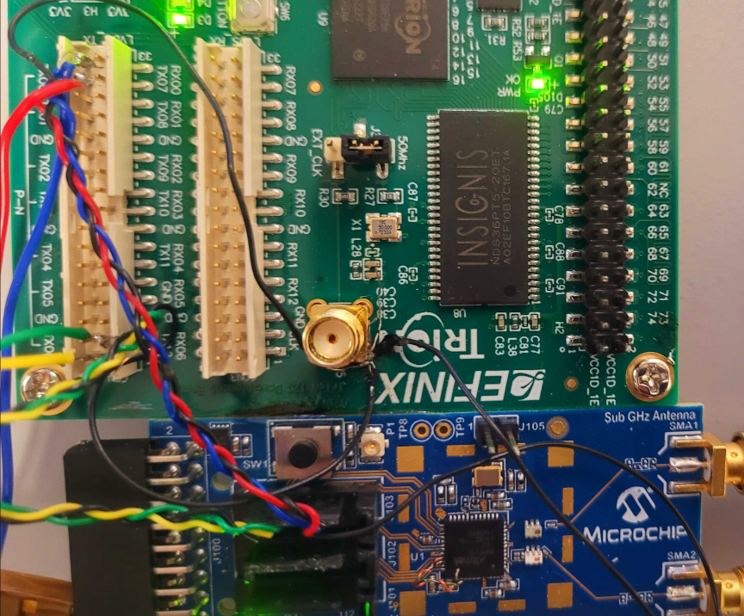
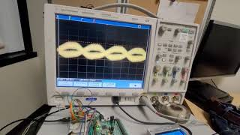
LVDS Functionality in I/Q Radio Mode-2
Connected TxCLK_P/N & data from FPGA & Downconverted to 100kHz.
Toggled IF WF by FPGA data on/off control.
TxD_P/N
FPGA
TxCLK_P/N
Transceiver
TxD_P/N
(* requires some line impedance trimming. Doesn`t work if otherwise )

Slide 30
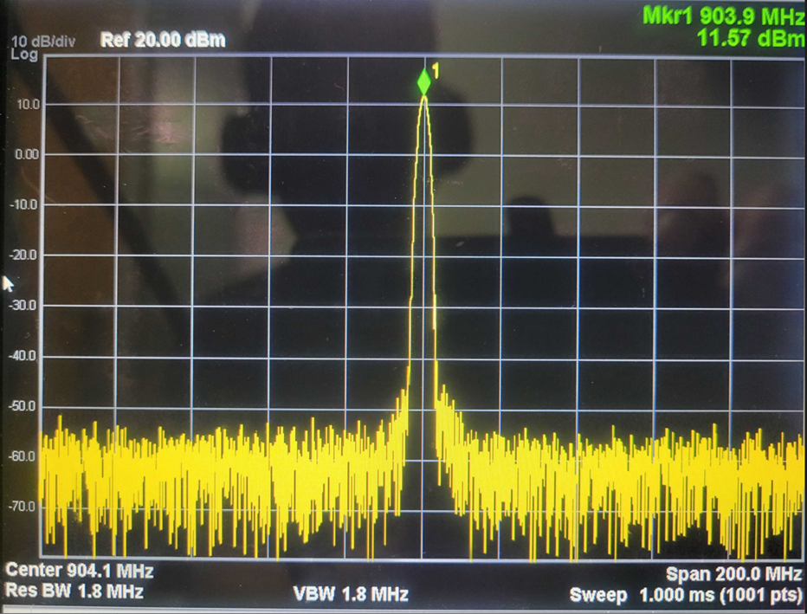
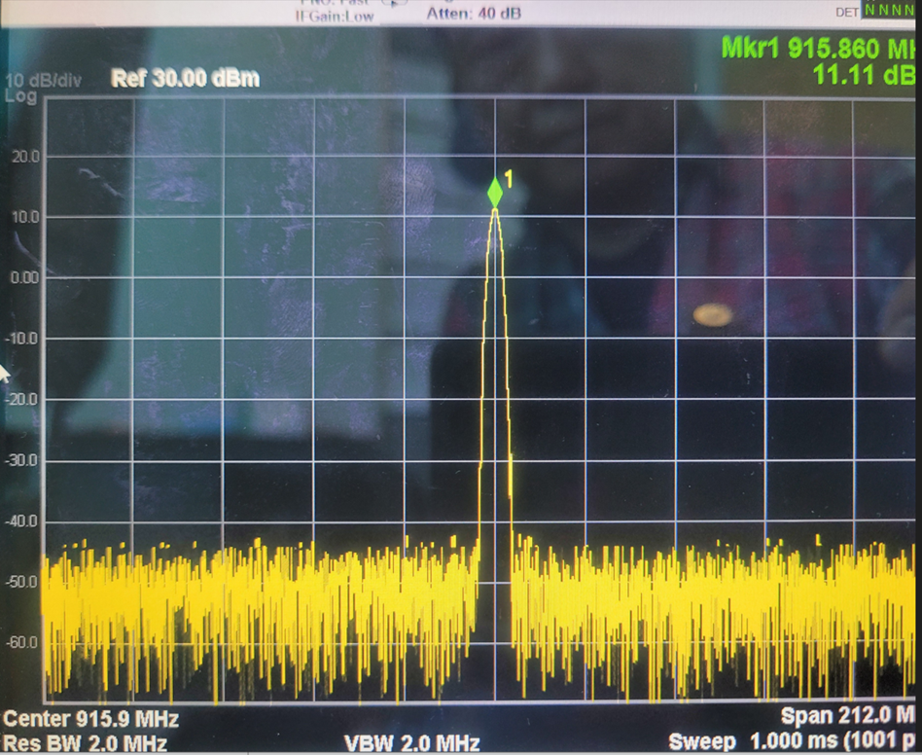
Transceiver Functionality
Freq. control
904 MHz
916 MHz

Slide 31
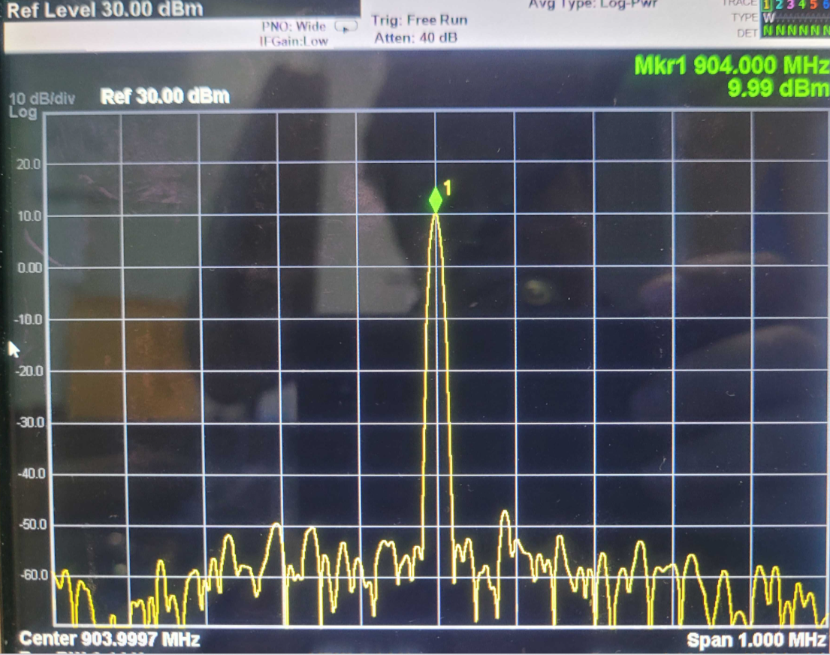
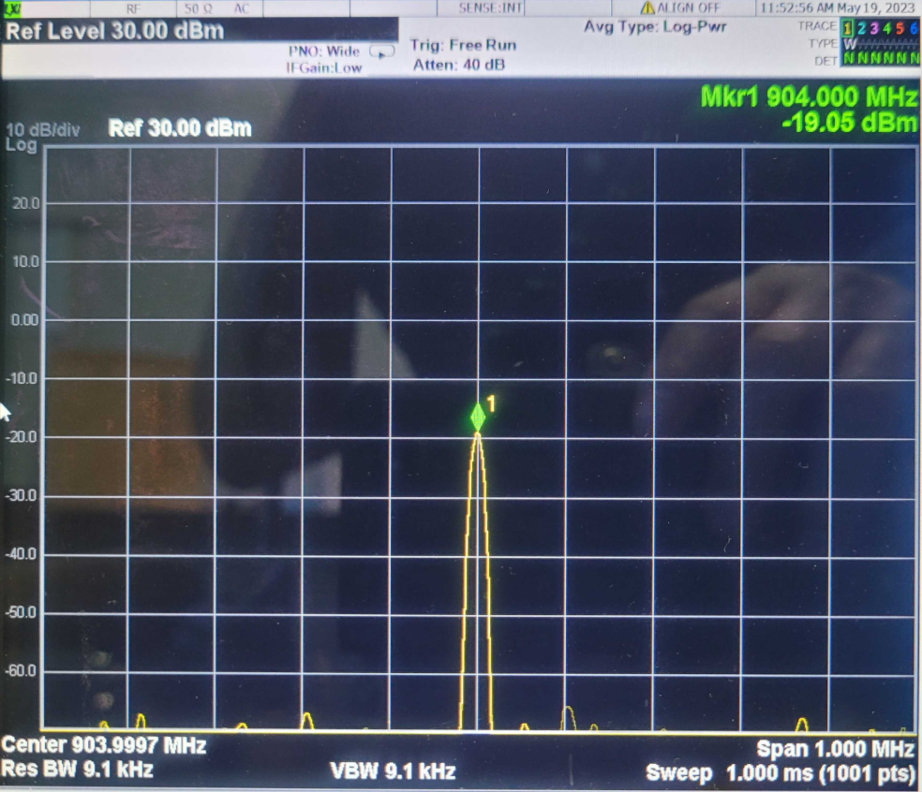
Transceiver Functionality
Pout. control
10dBm(0x0114:31)
-19dBm(0x0114:0)

Slide 32
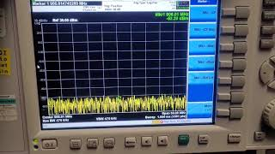
Transceiver Functionality
Tx/Rx toggling for push to talk( by Teensy analog input sensing )

Slide 33
Future Work
Getting LVDS to work so we can use our own FPGA implementation
Will come up with idea to verify LVDS functionality further with TxD_P/N to RxD_P/N loopback data while waiting for the FPGA is ready.
Transceiver side functionality support for contingency plan.
For sending packets to the OQPSK processor on the Atmel part directly via SPI
LVDS signal integrity improvement idea.
Further transceiver functionality check (RSSI ect.)

Slide 34
802.15.4 Project FPGA

Slide 35
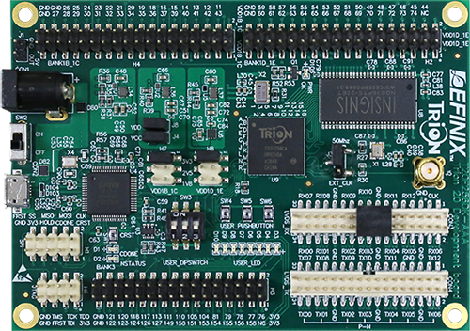
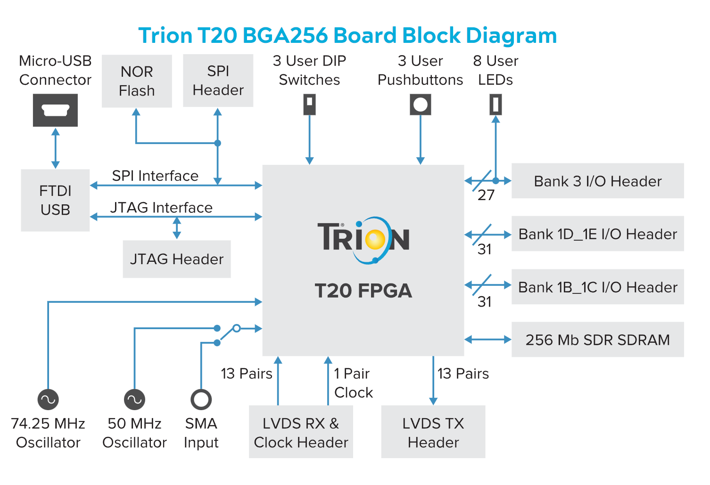
FPGA
Selected Efinix Trion T20 BGA256
Can do LVDS
Enough LUTs and Multipliers
Decent Toolchain

Slide 36
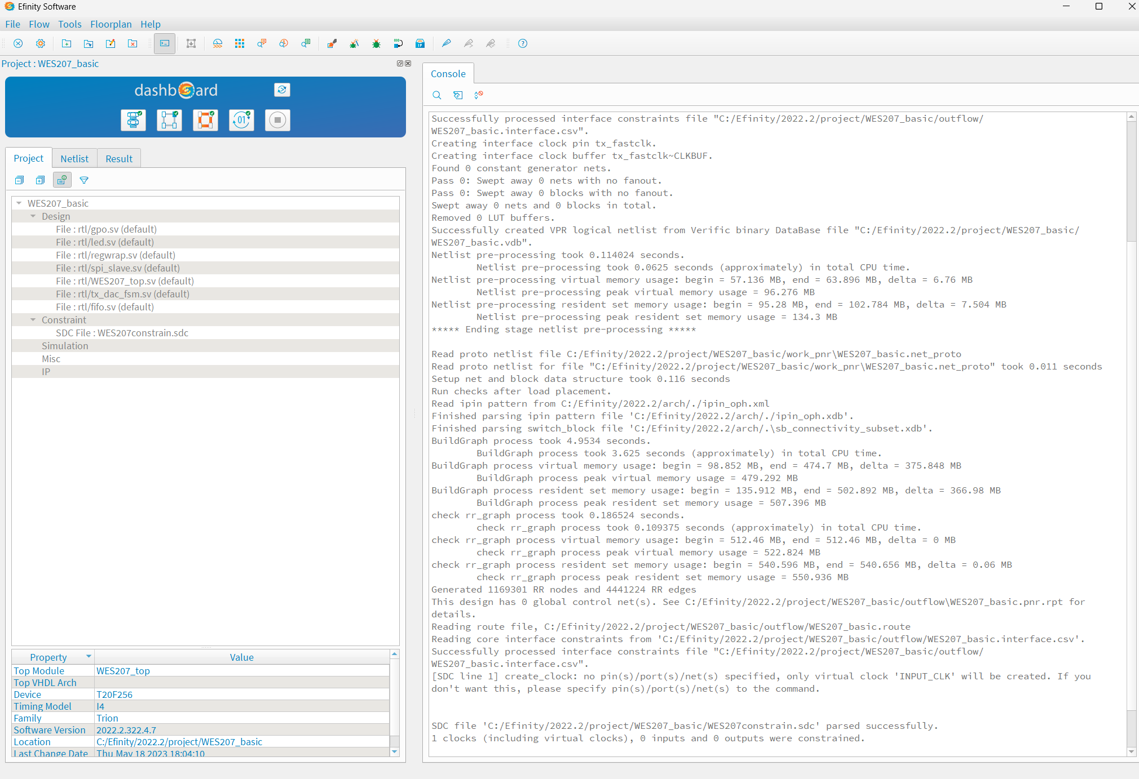
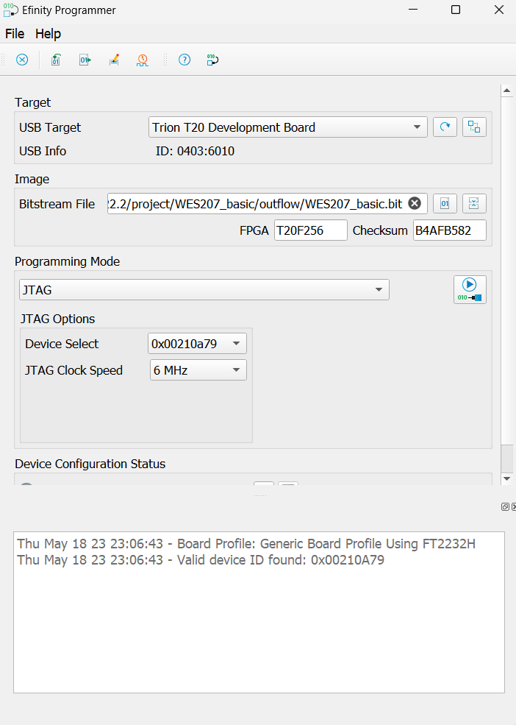
FPGA Block Diagram
HDL Blocks written in SystemVerilog
Sam wrote FIFOs after brief training
Synthesized, mapped to Efinity tool suite.
SPI
TARGET
REGWRAP
GPO
LED
TX FIFO
FIFO_INST
RX FIFO
DAC_FSM
LVDS

Slide 37
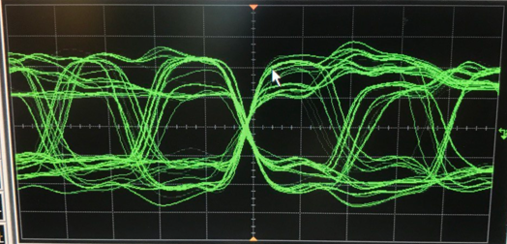
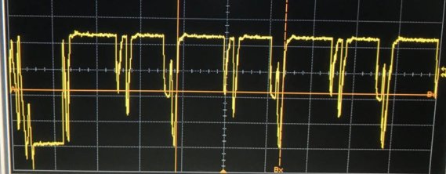
LVDS
TX LVDS is not functioning properly. It should look like:
Instead we get:

Slide 38
Future Work
Rewrite TX LVDS block to use integer interpolation
Build connector to connect Atmel clock to Efinix SMA CLK input so boards are synchronized [5/20]
Build connectors to go from SATA to 2-pin header for: [5/20]
TX LVDS
TX CLK LVDS
RX CLK LVDS
RX LVDS
Wire up RX LVDS to RX FIFO [5/21]
Send some packets (starting with ACK) [5/25]
Connect in Simulnk HDL coded blocks [memorial day hackathon]

Slide 39
Plan Going Forward
LVDS interface to RF Front End has proven to be a challenge, meaning we may need to work around it
We will explore two options in parallel:
Sending packets to the OQPSK processor on the Atmel part directly through SPI interface
Getting LVDS to work so we can use our own FPGA implementation
The direction we will take will be decided on this weekend
If successful, OQPSK can serve as MVP and BPSK w/ FPGA as a stretch goal
Looking to Simulink to generate HDL from our Rx simulation
Order of goals:
Demonstrate a packet transmitted and received (must complete)
Demonstrate a larger payload transmitted and received over multiple packets
Bring symbol rate into compliance with 802.15.4
Implement CSMA

